Slide 1
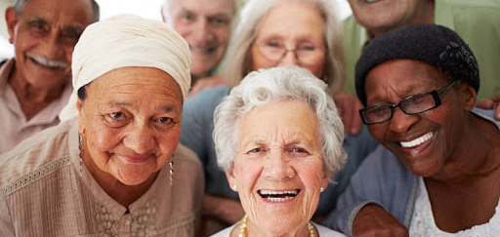

Older Adults: Nutrition & Immunity in the era of covid-19
Tia Jeffery, PhD, RDN, CHES

Slide 2
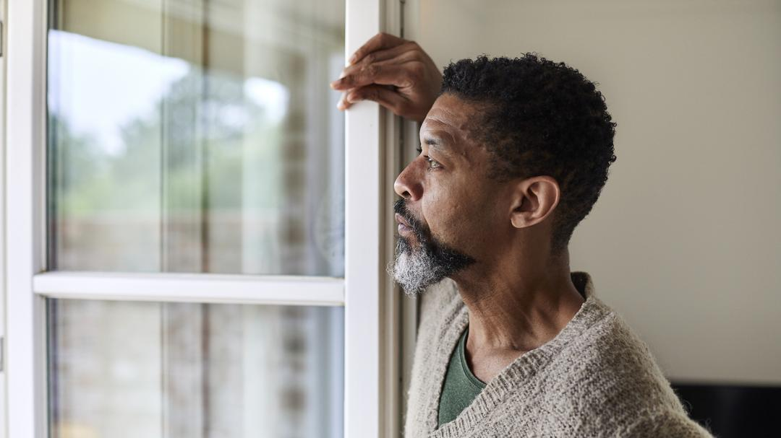
Older Adults & COVID-19
Older adults have been one of the most vulnerable groups with COVID-19 complications.
According to the Centers for Disease Control and Prevention, 8 out of 10 reported deaths from COVID-19 complications have been among those 65 and older.
Many young asymptomatic people have infected seniors with the virus.
With ongoing vaccinations, the trend in hospitalizations among the 60+ age group has been decreasing.
This Photo by Unknown Author is licensed under CC BY-NC

Slide 3
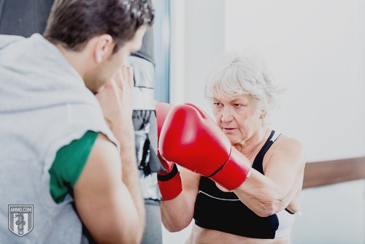
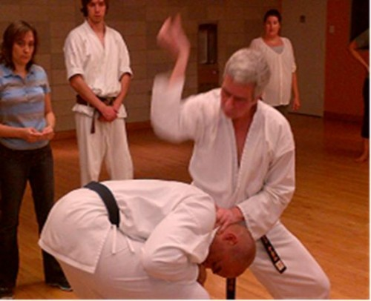
WEAPONS OF DEFENSE

Slide 4

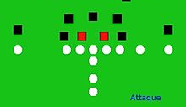
Building Defenses
Exposure to some toxins, intentional or not, is going to happen.
We can prepare our bodies for defense against cell damage from exposure to viruses through adequate intake of “powerhouse” nutrients and vaccines.

Slide 5
What’s Diet Got To Do With It?
The COVID-19 pandemic has led to an devasting number of illnesses and deaths all over the world.
Vaccinations look promising.
But what about our nutrition status?

Slide 6
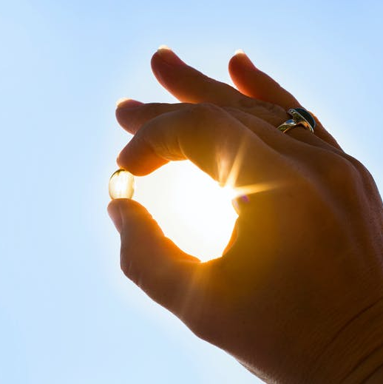
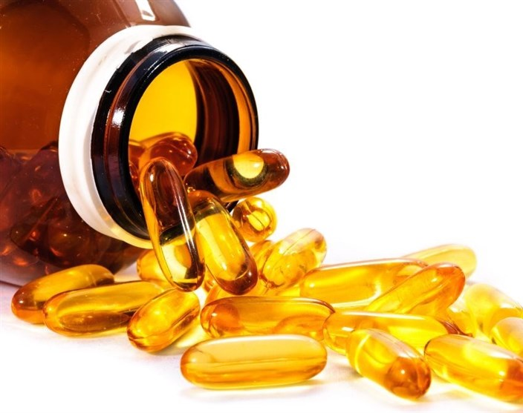
VITAMIN D
Over 80% of hospitalized patients with COVID-19 were deficient in Vitamin D.
Vitamin D supports our immune system and reduces risk of infection.
Sources: Direct sunlight (UV Rays), fish, egg yolks, fortified dairy products, fortified beverages
Supplements: Most Americans, especially people of color, need to supplement with Vitamin D3 (1,000 to 4,000 units daily, depending on Vitamin D level (Consult your Physician about recommended amounts).
Hernandez et al. (2021). Vitamin D status in hospitalized patients with SARS-CoV-2 Infection. The Journal of Clinical Endocrinology & Metabolism, 136(e1343-e1353).
This Photo by Unknown Author is licensed under CC BY
This Photo by Unknown Author is licensed under CC BY-SA

Slide 7
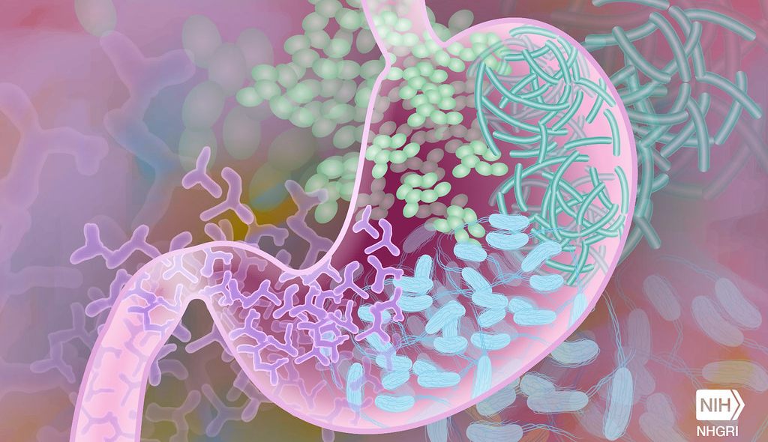
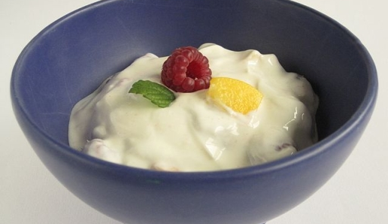
PROBIOTICS
There have been links between COVID-19 and intestinal imbalance of healthy gut bacteria.
There’s a gut-lung connection in the immune system response to COVID-19 virus.
Various strands of probiotics contain health living bacteria for our gut.
One China study noted higher survival of hospitalized patients treated with probiotics compared to those who were not.
Sources: Fermented dairy (yogurt and kefir), non-dairy yogurt w/ active cultures, kimchi, sauerkraut, mushrooms, probiotic supplements.
*Disclaimer: Do not take if you are neutropenic.
Li et al. (2021). The role of probiotics in coronavirus disease-19 infection in Wuhan: A retrospective study of 311 severe patients. International Immunopharmacology, 95, 10753.
Galdeano et al. (2019). Beneficial effects of probiotic consumption on the immune system. Annals of Nutrition & Metabolism, 74(115-124).
This Photo by Unknown Author is licensed under CC BY-NC
This Photo by Unknown Author is licensed under CC BY-NC-ND

Slide 8
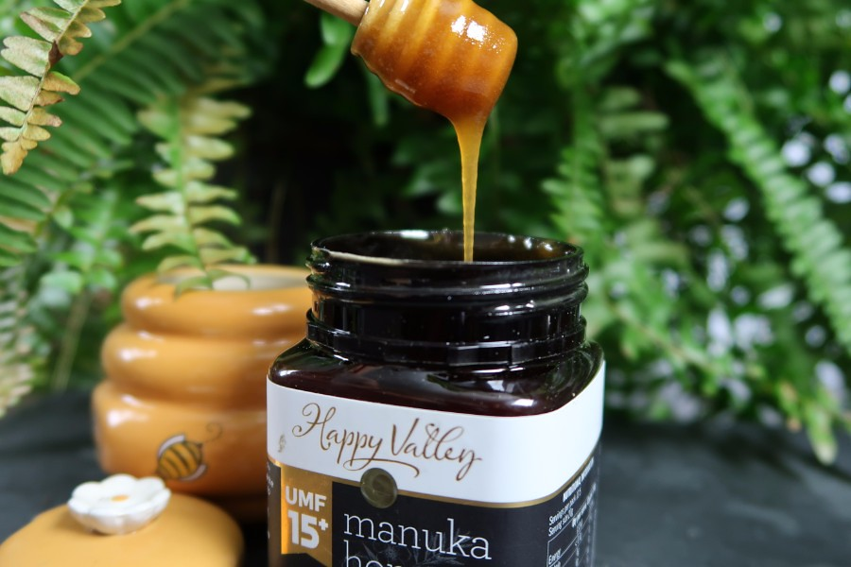
Honey
Honey has a long history of use in traditional herbal medicine.
Increases levels of antioxidants like Vitamin C and selenium in the body.
Improves the activity of immune cells.
Phytochemicals in honey may promote the removal of damaged cells.
Propolis, a compound in honey, blocks proteins that cause inflammation from viruses.
Hossain et al. (2020). Prospects of honey in fighting against COVID-19: pharmacological insights and therapeutic promises. Heliyon, e05798.
Berretta et al. (2020). Propolis and its potential against SARS-CoV-2 infection mechanisms and COVID-19 disease. Biomedicine & Pharmacotherapy, 131, 110622.
This Photo by Unknown Author is licensed under CC BY

Slide 9
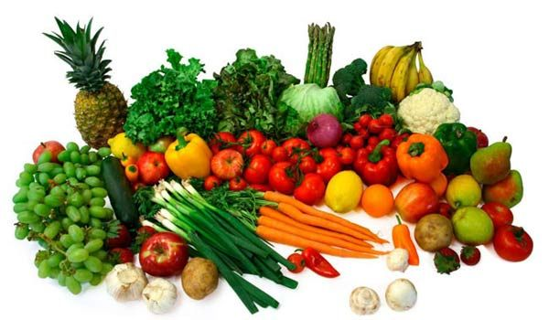
Functional Foods, Exercise, & Rest
A plant-based diet that includes 6 or more servings of fruits and vegetables daily will provide ample amounts of medicinal nutrients to help ward off infection.
Regular exercise 3-5 times per week at a moderate to heavy pace for 30-60 minutes strengthens immunity, heart health, mental clarity, and lungs.
Adequate sleep of 7-8 hours every night strengthens our immune function.
The phytochemicals in whole plant-based foods have reduced viral activity of the COVID-19 virus in research experiments.
Chojnacka et al. (2020). Phytochemicals containing biologically active polyphenols as an effective agent against COVID-19-inducing virus. Journal of Functional Foods, 73, 104146.

Slide 10

This Photo by Unknown Author is licensed under CC BY-NC

