Slide 1
TERRIFIC, Inc.
(Temporary Emergency Residential Resource
Institute for Families in Crisis)

Slide 2
DECLUTTERING TO SUPPORT YOUR COMMUNITY
Presented by:
Davette Rucker, OTR/L
Occupational Therapist
05/21/21

Slide 3
JOIN US ON TUESDAY MORNINGS AT 10 A.M.
Decluttering Class and Discussion Group - Tuesdays 10 a.m. – 11 a.m.
TERRIFIC, Inc. Telephone Conference Line: (202) 869-8585
(Access code: 2373826#)
Register for the class at: www.terrificinc.org
Obtain the motivation you need to declutter you home
Learn the different methods for decluttering and how to get started
Learn tips for decluttering mail and papers
Learn how to establish routines to maintain a clutter-free home.
Share your stories, experiences and tips for decluttering, cleaning and organizing with other participants.
Receive resources: places to donate and recycle items, checklists, handouts

Slide 4
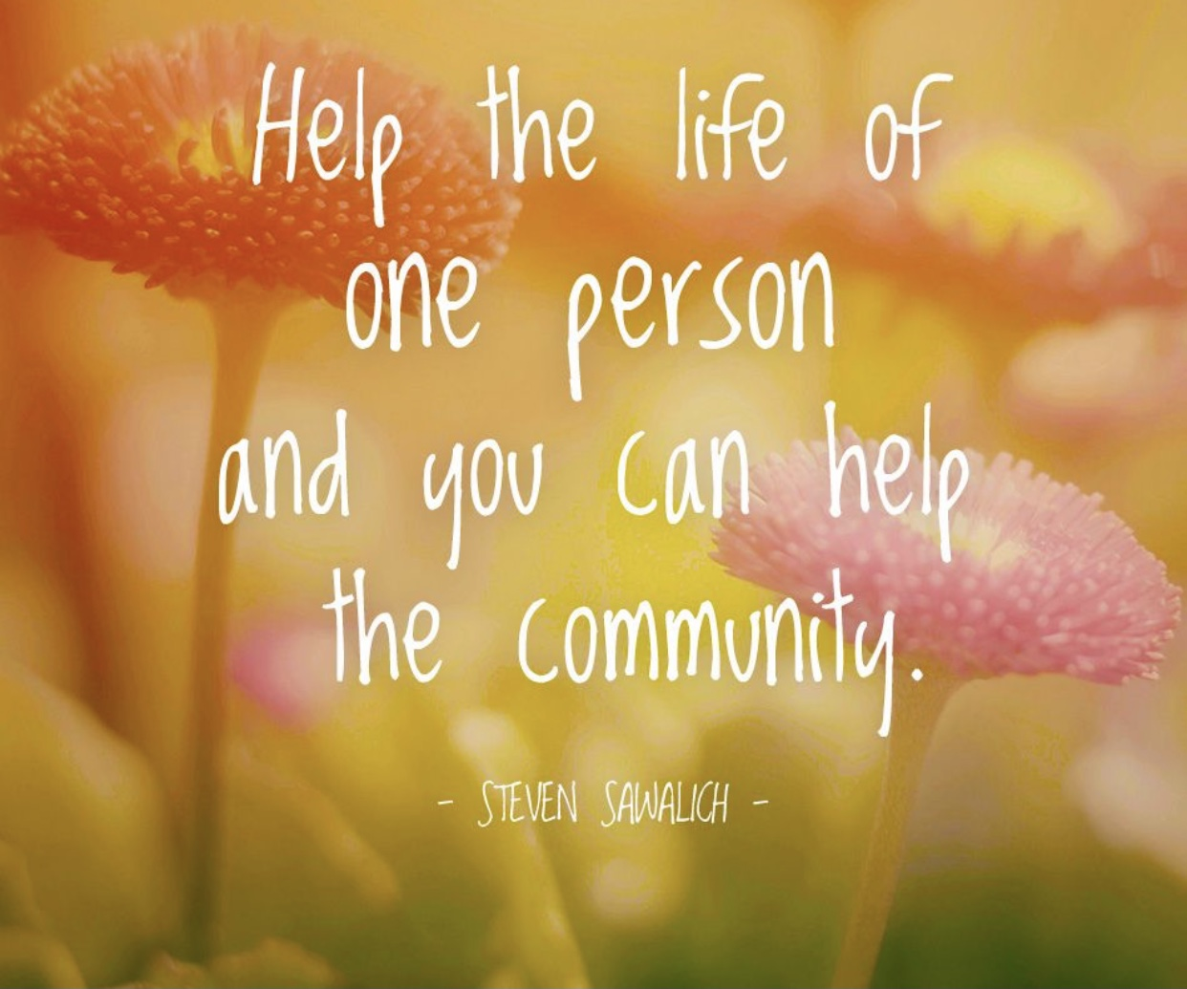
SUPPORT YOUR COMMUNITY BY DECLUTTERING YOUR HOME
We can help individuals in need when we declutter our home. We can provide new and gently used clothes, household items and non-perishable food to organizations that help people in need.

Slide 5
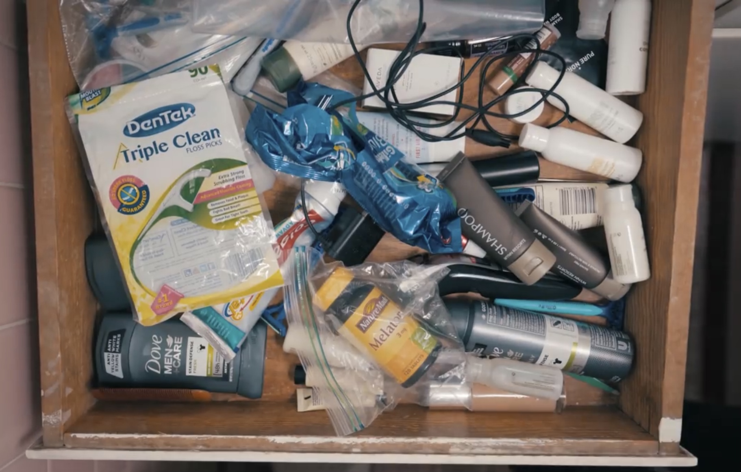
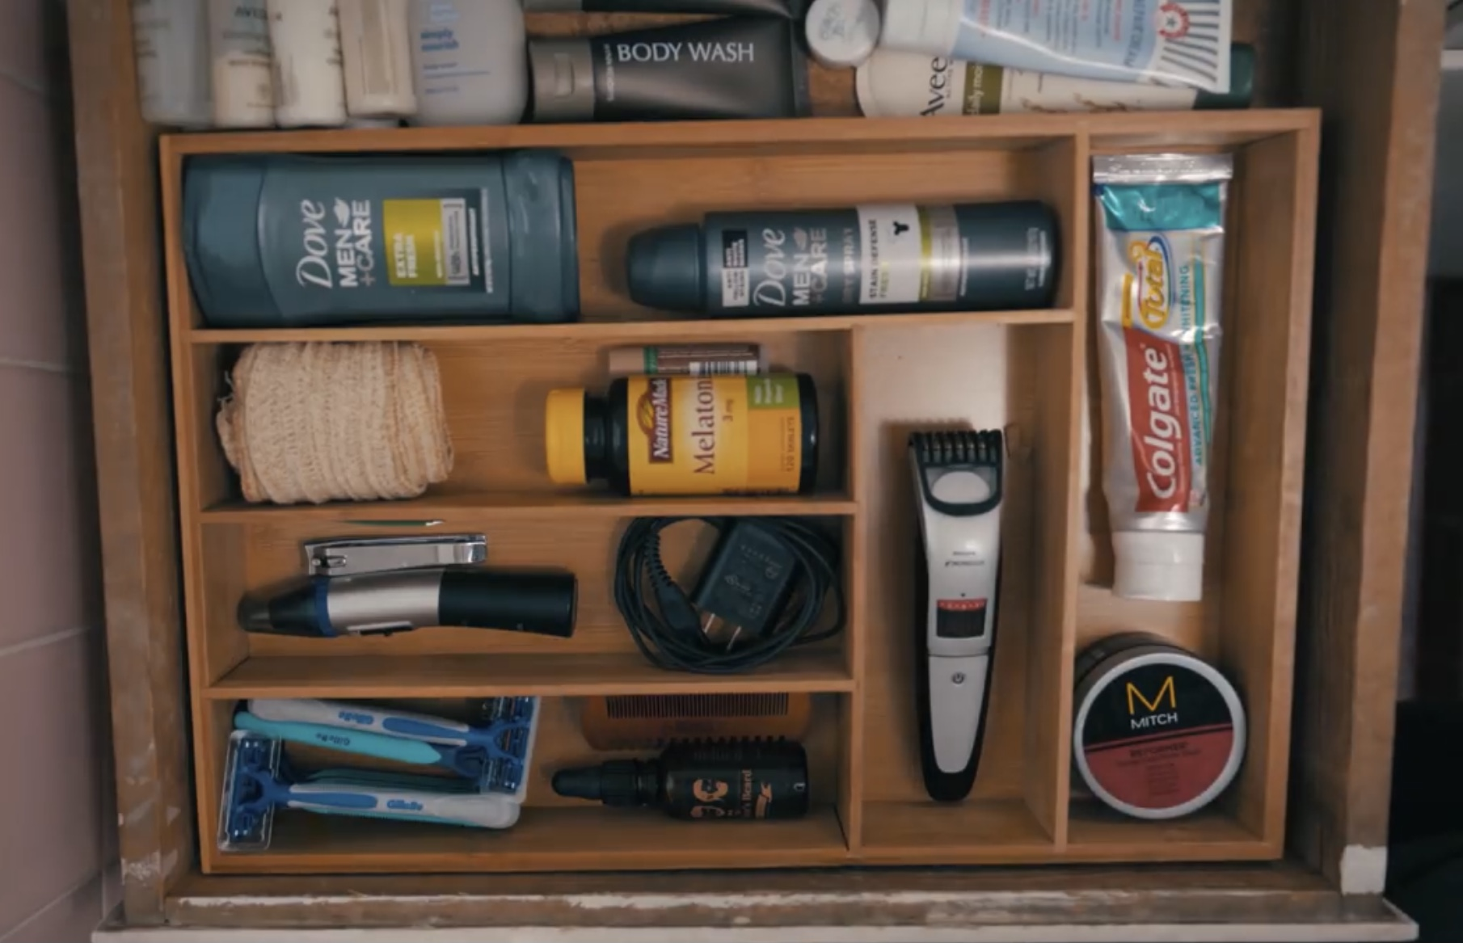
DEFINITIONS
CLUTTER
A lot of disorganized stuff in one place that contains items that you do not use or need.
DECLUTTERING
The process of identifying and removing items that you do not use or need from a space.

Slide 6
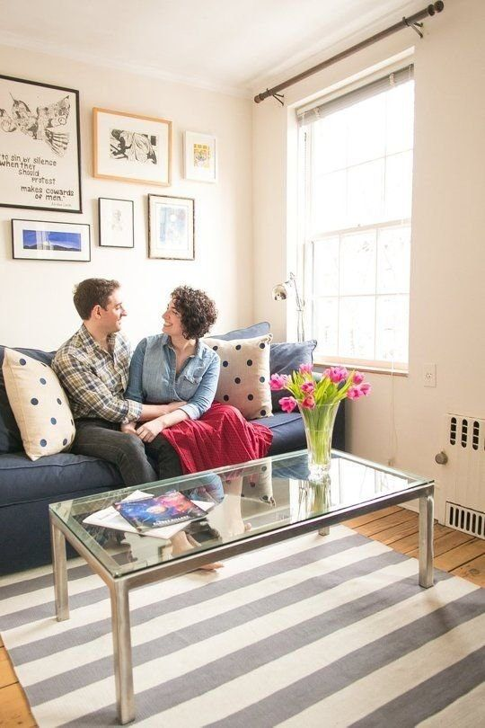
WHY IS DECLUTTERING IMPORTANT?
Decluttering and organizing helps us take control of our home, life and items.
Decluttering:
provide space for necessities
increases efficiency to complete tasks when items are in their designated area
improves safety for mobility throughout the home
allows us to help others in need
reduces stress and anxiety
saves money by minimizing the need to purchase misplaced items

Slide 7
WHAT OBSTACLES PREVENT YOU FROM DECLUTTERING YOUR HOME?
Decreased energy or strength
Decreased motivation
Procrastination
Feeling overwhelmed by the amount of stuff
Decreased mobility
Decreased knowledge about decluttering and organizing
No daily or weekly routine for completing household tasks
Decreased family support

Slide 8
SIX COMMON TYPES OF CLUTTER
Clutter without a designated space - A pile of mail on a table, groceries on the dining room table, multiple remote controls on the sofa.
Trash masquerading as clutter - Expired food, broken items that you have not fixed in months, old newspapers, and empty bottles.
Bargain clutter - Items that you bought because they were on sale that you do not really need. Also, items that you accept from someone, because it was free, but you really don’t need it.
Abundance clutter - Having too many items that you need: four jars of expired spaghetti sauce in your pantry. Clothes that still have tags on them 12 months after you purchased them.
Aspirational clutter - Items that you bought to pursue a hobby or learn something new, but you do not use it. You bought a George Foreman Grill to cook healthier meals for your family, but you stop using it after the first week.

Slide 9
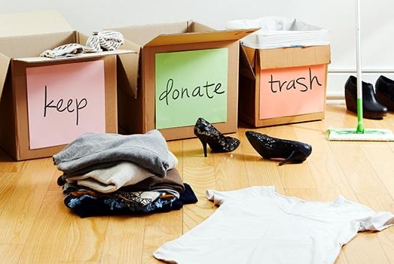
HOW TO DECLUTTER
THE 3 BOX METHOD FOR DECLUTTERING
Use three boxes, bags or bins to identify:
Items to Keep
Items to Donate
Items to Trash

Slide 10
QUESTIONS T0 ASK YOURSELF WHEN DECLUTTERING
Do I use this item?
Do I foresee myself using this item in the next few months?
Do I really need this item?
When was the last time I used the item?
Do I have more than one?
Am I keeping this item to hold onto the past?
Am I worried that I will not be able to replace it if I get rid of the item?
Is the item broken or damaged? If so, how likely am I to fix it?

Slide 12
DONATION GUIDELINES
DO NOT DONATE ITEMS THAT ARE:
DONATE ITEMS THAT ARE:
Broken or Chipped
Torn
Dirty or Stained
Soiled with mold
Inoperable
Missing pieces
Covered in animal hair, rodent waste, roach or bed bug eggs and debris
New items
Gently used items
Unexpired foods items
Placed in bags or boxes to deliver to the organization

Slide 13
GOODWILL’S ACCEPTABLE DONATIONS LIST
Vehicles in all conditions/Boats on trailers
Clothing, shoes and boots
Jewelry
Hats, gloves, mittens and scarves
Books, records, compact disks, video tapes and DVDs
Games, toys and sports equipment
Housewares: dishes, glassware, kitchen utensils, lamps and small appliances
Hand tools and small power tools
Collectibles, antiques, knickknacks and other giftware
Domestics: linens, curtains, blankets, etc.
Electronics: Stereos, radios, VCRs, DVD players, etc.
Furniture: dressers, tables, sofas, bed frames, (except waterbed frames) etc.
Flat screen TVs
Computer
Office Equipment
Telecommunications Equipment

Slide 14
GOODWILL’S UNACCEPTABLE DONATION LIST
CRT Televisions/CRT Computer Monitors (cathode ray tube)
Household chemical products: pesticides, paint, drain/oven cleaner, etc.
Automotive hazardous waste items: tires, lead acid batteries, oils, antifreeze, etc.
Large appliances: refrigerators, stoves/ovens, washers/dryers etc.
Personal care items: shampoo, conditioner, shaving cream
No mattresses/box springs or waterbeds
No carpet or carpet padding
No plumbing fixtures
No building materials
No traditional recyclables: newsprint, cardboard, magazines, etc.
No weapons such as guns, bows and arrows, ammunition, etc.
No cribs, car seats, walkers or other products that do not meet the current safety standards of the US Consumer Product Safety Commission, including recalled items.
No pianos or organs

Slide 15
DONATIONS TO CONSIDER FOR SHELTERS
GENTLY USED ITEMS
Clothes
Coats/Jackets/Sweaters
Shoes/Boots
Hats/Gloves
Blankets/Sheets
Sturdy Tote Bags/Book Bags
NEW ITEMS
Toilet Paper/Paper Towel
Underwear/Socks
Oral Hygiene Products (toothbrushes/toothpaste)
Unopened Toiletries (razors, shaving cream, deodorant, perfume/cologne)
Feminine Hygiene Items
Diapers/Incontinence Items
Face Masks
First Aid Supplies
New Laundry detergent/All Purpose Cleaner
New Cleaning products/Trash bags

Slide 16
PLACES TO DONATE AND RECYCLE
SOME -So Others Might Eat (www.some.org) – regular and professional clothes, non-perishable food and small household items
The Lupus Foundation (www.lupuspickupmdva.org/.org)
Goodwill
Salvation Army (https://satruck.org/schedule-pickup)
Thrift stores
Churches with clothing closets and food pantries
D.C. Shares Medical Equipment Loan Closets
Dress for Success (Business/professional clothes)
Lion’s Club (www.lionsclub.org) - eyeglass recycling program
A Wider Circle (furniture and household goods)
Habitat for Humanity
Capital Area Food Bank
Community Forklift (new, used and salvaged building and landscaping materials, appliances, tools)
Homeless Shelters
Fort Totten Solid Waste Disposal Transfer Station: Dispose of electronics and bulk trash. Provides personal document shredding.

Slide 17
JOIN US ON TUESDAY MORNINGS AT 10 a.m.
Decluttering Class and Discussion Group - Tuesdays 10 a.m. – 11 a.m.
TERRIFIC, Inc. Telephone Conference Line: (202) 869-8585
(Access code: 2373826#)
Register for the class at: www.terrificinc.org
Obtain the motivation you need to declutter you home
Learn the different methods for decluttering and how to get started
Learn tips for decluttering mail and papers
Learn how to establish routines to maintain a clutter-free home.
Share your stories, experiences and tips for decluttering, cleaning and organizing with other participants.
Receive resources: places to donate and recycle items, checklists, handouts

Slide 18
REFERENCES
https://simplelionheartlife.com
https://www.macmillandictionary.com
https://communityforklift.org
https://dpw.dc.gov
https://www.amazinggoodwill.com/donating/donor-guidelines
https://mashable.com/2015/06/09/items-to-donate-unexpected
https://www.amazinggoodwill.com/donating/donor-guidelines
https://theccnv.org
https://dcgoodwill.org
https://satruck.org/schedule-pickup
https://thespruce.com
http://lupuspickupmdva.org
https://www.nbc12.com/2021/05/19/goodwill-stores-have-message-please-stop-donating-trash/

